Slide 1


Comparing Current Housing Prices to Expected Housing Prices in Minneapolis/St.Paul
Ben Peters
03/05/2026

Slide 2

Agenda
Goal/Reason for Modeling
Available Data
Plan for Data Workup and Modeling
Data Cleanup Strategy
Exploratory Data Analysis
Summary of Modeling Outcomes
Final Conclusions
Next Steps

Slide 3

Predicting Minneapolis/St.Paul Housing Data: Why Do it?
For the general home buyer, why a price is set the way it is may not make sense
  Why is one home much more expensive than the other?
This may lead the home buyer to pay way too much for a house, or miss an incredible deal
In order for the homebuyer to have a better idea of housing costs, a model could be used to predict the cost, and then the home buyer could compare to the expected price given by the model
Image from: Minneapolis Housing Market: Trends and Forecast 2025-2026

Slide 4
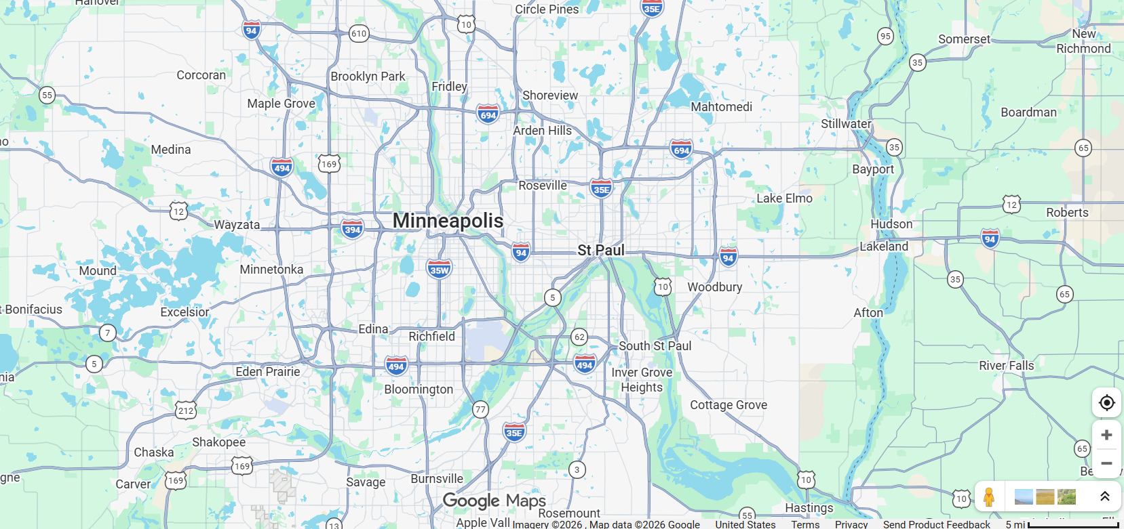
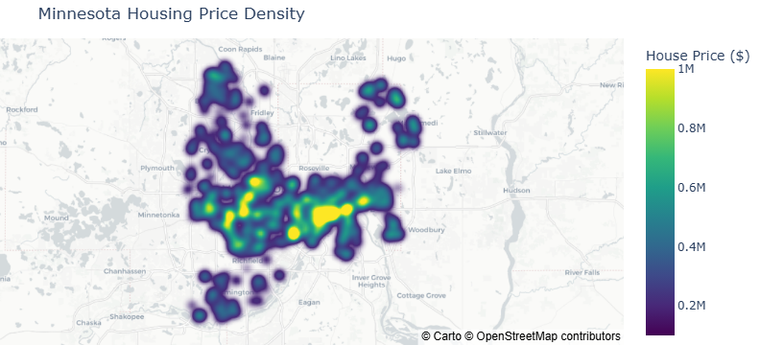
Data Overview:
All houses were on the market at the time the data was acquired
Initial dataset had 702 properties sourced from Kaggle/Redfin
All properties were from the Minneapolis/ St. Paul area
  Limiting the scope allows for less effects from differing laws, taxes, and other data that was not readily available
Data Sourced From: https://www.kaggle.com/datasets/thuynyle/redfin-housing-market-data

Slide 5
Plan for Data Cleanup and Modeling
Removing Null Values and Specific Features
Feature/Price Correlation
Linear
Data Cleanup
Initial Data Analysis
Modeling
Random Forest
XGBoost
Simple Neural Network
Notes on Data Cleanup for Data Points:
  31 total data points were removed because they were vacant land
    Remaining 671 samples were used for modeling/testing
Notes on Data Cleanup for Features:
  11 features were removed
    Features included information that was not useful for modeling such as state (all samples are in MN), URL, Sold Date (all houses were on market)

Slide 6
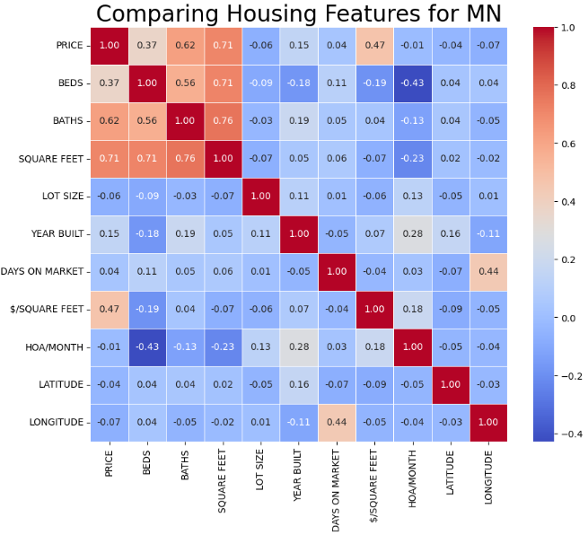
Feature Correlation with Housing Prices
All numerical features were compared to Price to determine if there are any correlations
Beds, Baths, Square feet and Price/Square foot all exhibited a positive correlation
Likely multicollinearity
Next step: Explore the relationships of these features with Price
Interestingly, the # Beds had a loose negative correlation with HOA/Month
  Likely smaller residences such as condos

Slide 7
Feature Correlation with Housing Prices
All numerical features were compared to Price to determine if there are any correlations
Beds, Baths, Square feet and Price/Square foot all exhibited a positive correlation
Likely multicollinearity
Next step: Explore the relationships of these features with Price
Interestingly, the # Beds had a loose negative correlation with HOA/Month
  Likely smaller residences such as condos

Slide 8
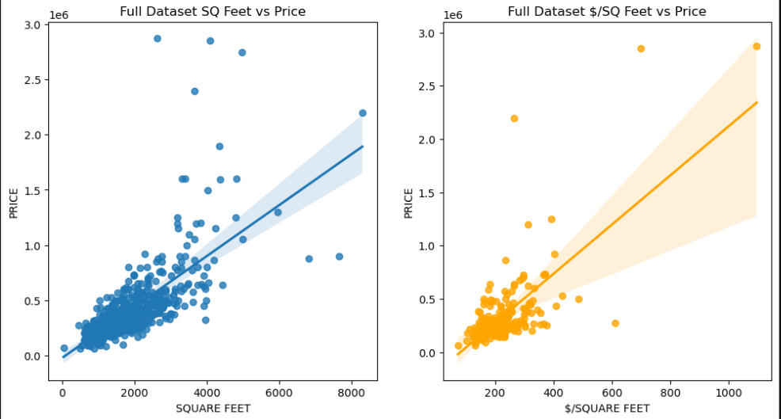
Feature Correlation with Housing Prices: Square Feet
Square feet has a weak correlation with price
  This is expected as intuitively larger housing units cost more to build and are in higher demand
A similar conclusion can be made for Price per square foot
  Feature removed for modeling purposes
R² = 0.504
P < 0.0001
R² = 0.220
P < 0.0001

Slide 9
Feature Correlation with Housing Prices: Square Feet
Square feet has a weak correlation with price
  This is expected as intuitively larger housing units cost more to build and are in higher demand
A similar conclusion can be made for Price per square foot
  Feature removed for modeling purposes
R² = 0.504
P < 0.0001
R² = 0.220
P < 0.0001
Feature Removed to Prevent Data Leakage

Slide 10
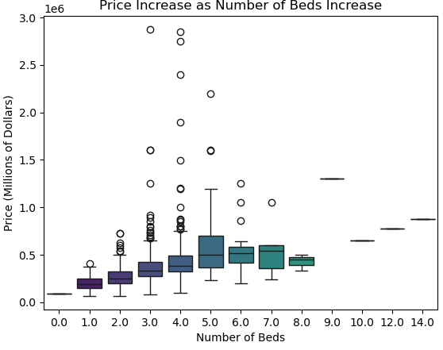
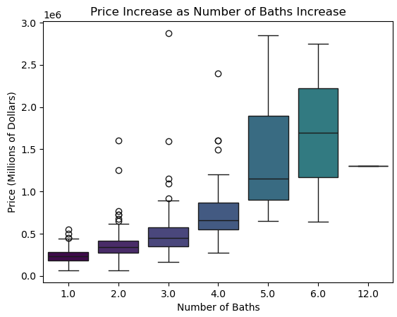
Feature Correlation with Housing Prices: Beds/Baths
Generally, As the number of beds and baths increase, the price increases as well
  Price does not seem to increase after 5 beds (very large housing unit
Through a Pairwise Tukey significance test the price was found to be significantly different for groups of <3 beds, 3-5 beds, and >5 beds (p < 0.05)
Also using the pairwise Tukey significance test, groups of <3 baths, 3-4 baths, and >4 baths were all found to be significant (p < 0.05)

Slide 11
Modeling Summary: Model Optimization
All models used the same data split (80% training, 20% testing)
Random Forest and XGBoost models were optimized using a randomize cross validation parameter search to optimize model parameters
  The models were then further optimized using gridsearch as long as the test MAE did not increase (preventing overfitting)
Neural Network parameters such as learning rate and # of epochs were modified and optimized to obtain the best fit possible

Slide 12
Modeling Summary: Choosing the Best Model
Model | R² | MAE | Low Price (<$300K) | Med Price ($300K-$500K) | Med-High Price ($500K-$1M) | High Price (>$1M)
# of samples | 135 | 135 | 61 | 49 | 20 | 5
Linear – Best Fit | 0.66 | $98,053 | 30.51% | 21.4% | 24.81% | 26.45%
Linear – Ridge | 0.54 | $96,896 | 33.67% | 20.43% | 19.75% | 32.87%
Linear – Lasso | 0.67 | $99,996 | 32.78% | 22.14% | 23.82% | 26.83%
Random Forest | 0.66 | $88,425 | 28.62% | 16.90% | 24.38% | 30.04%
XGBoost | 0.68 | $82,132 | 27.24% | 15.57% | 21.00% | 30.78%
Simple Neural Network | 0.70 | $80,114 | 22.7% | 18.08% | 22.86% | 23.51%
To understand the model limitations further, the Mean Absolute Percentage Error was determined for different pricing bins
XGBoost and Neural Network exhibited the lowest error on the test dataset
* MAE = Mean Absolute Error

Slide 13
Modeling Summary: Choosing the Best Model
Model | R² | MAE | Low Price (<$300K) | Med Price ($300K-$500K) | Med-High Price ($500K-$1M) | High Price (>$1M)
# of samples | 135 | 135 | 61 | 49 | 20 | 5
Linear – Best Fit | 0.66 | $98,053 | 30.51% | 21.40% | 24.81% | 26.45%
Linear – Ridge | 0.54 | $96,896 | 33.67% | 20.43% | 19.75% | 32.87%
Linear – Lasso | 0.67 | $99,996 | 32.78% | 22.14% | 23.82% | 26.83%
Random Forest | 0.66 | $88,425 | 28.62% | 16.90% | 24.38% | 30.04%
XGBoost | 0.68 | $82,132 | 27.24% | 15.57% | 21.00% | 30.78%
Simple Neural Network | 0.70 | $80,114 | 22.7% | 18.08% | 22.86% | 23.51%
To understand the model limitations further, the Mean Absolute Percentage Error was determined for different pricing bins
XGBoost and Simple Neural Network
exhibited the lowest error on the test dataset
  Neural network was a simple 3-layer network
* MAE = Mean Average Error

Slide 14
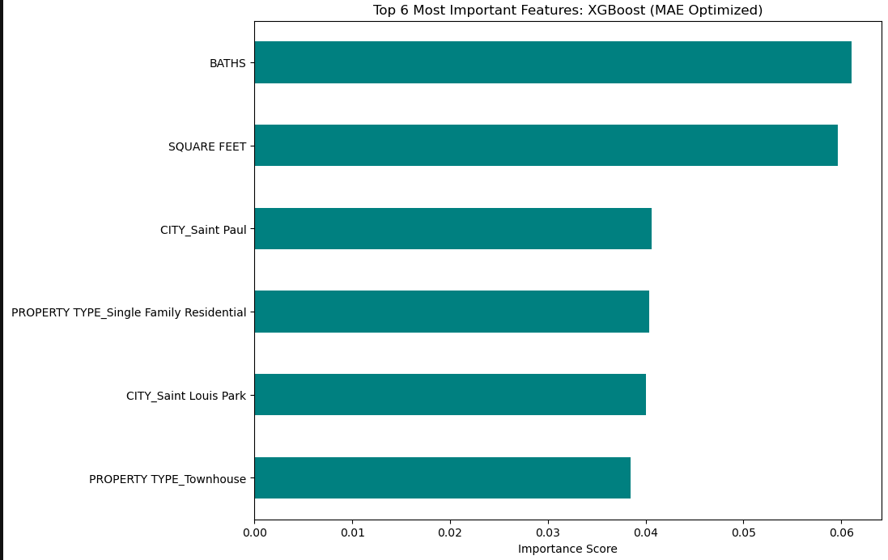
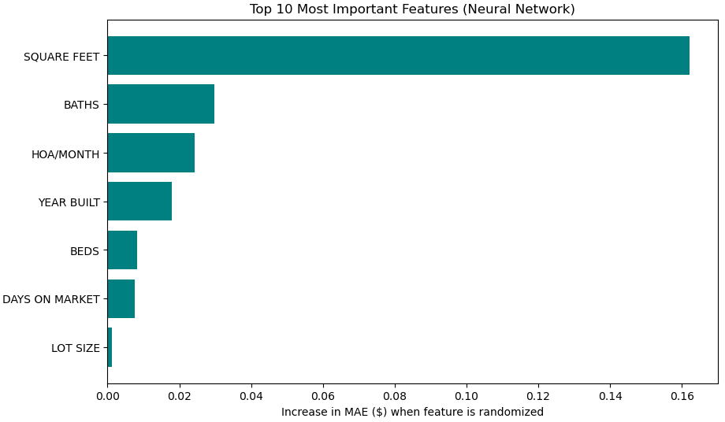
Modeling Summary: Feature Importance

Slide 15

Conclusions and Next Steps
Conclusions
  Depending on the price range, XGBoost or Neural Network would be the best models
  Neural Network is the overall winner due to its consistency across price ranges
  Ideally, these models would have less than 10% error
    May need more data and feature engineering to make this happen
  The models given here can give an idea as to whether a house is significantly over/under priced, but more refinement and data are needed to be more specific
Next Steps
  Obtain more data – more housing information would be very helpful and would allow for separating the houses based on price for modeling of separate bins
  Gather more information about features
    Features such as if there is a pool, granite countertops, newly remodeled, distance from schools, etc.
  Further optimization of the Neural Network model
    This was an initial Neural Network model that can be tuned further

